Slide 1

University Institute of Engineering
DEPARTMENT OF COMPUTER SCIENCE & ENGINEERING
Bachelor of Engineering (Computer Science & Engineering)
Subject Name : Machine Learning
Subject Code: CST-316
Topic: Principal Component Analysis
Lecture-3.3
DISCOVER . LEARN . EMPOWER

Slide 2
Course Outcomes
CO-1:Apply the basic concept of Machine learning and statistics learning to deal with real-life Problems.
CO-2: Understand different machine learning algorithms, as well as underlying theories the behind them.
CO-3: Select and apply the appropriate machine learning algorithm to solve problems of moderate complexity
CO-4: Interpret and evaluate models generated from data.
CO-5: Optimize the models learned and report on the expected accuracy that can be attained by applying the algorithms to a real-world problem.

Slide 3
Course Objectives
To understand the history and development of Machine Learning.
To provide a comprehensive foundation to Machine Learning and Optimization methodology with applications t.
To study learning processes: supervised and unsupervised, deterministic and statistical knowledge of Machine learners, and ensemble learning
To understand modern techniques and practical trends of Machine learning.

Slide 4
CONTENTS
Intuition behind PCA
Theory behind PCA
Applications of PCA
Extensions of PCA

Slide 5
Introduction
Most of the scientific or industrial data is Multivariate data (huge size of data)
Is all the data useful?
If not, how do we quickly extract useful information only?

Slide 6
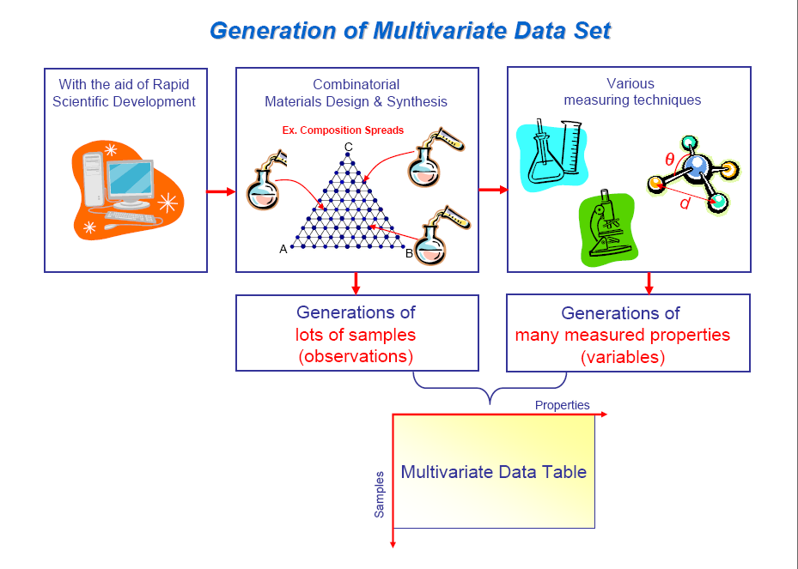

Slide 7
Problem
When we use traditional techniques,
1. Not easy to extract useful information from the multivariate data
1) Many bivariate plots are needed
2) Bivariate plots, however, mainly represent correlations between variables (not samples).

Slide 8
Dimensionality reduction
Another way to simplify complex high-dimensional data
Summarize data with a lower dimentional real valued vector
Given data points in d dimensions
Convert them to data points in r<d dimensions
With minimal loss of information

Slide 9

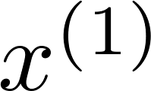
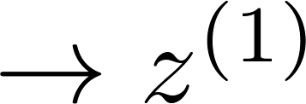
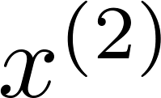
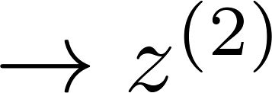
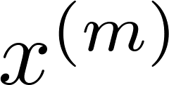
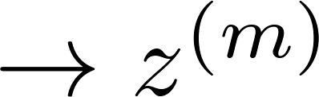


Data Compression
Reduce data from
2D to 1D
(inches)
(cm)
Andrew Ng
Notes:
Add more unique colors (3-4)

Slide 10
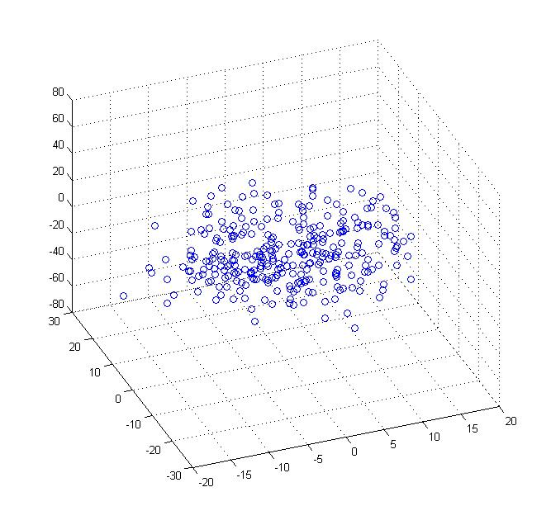
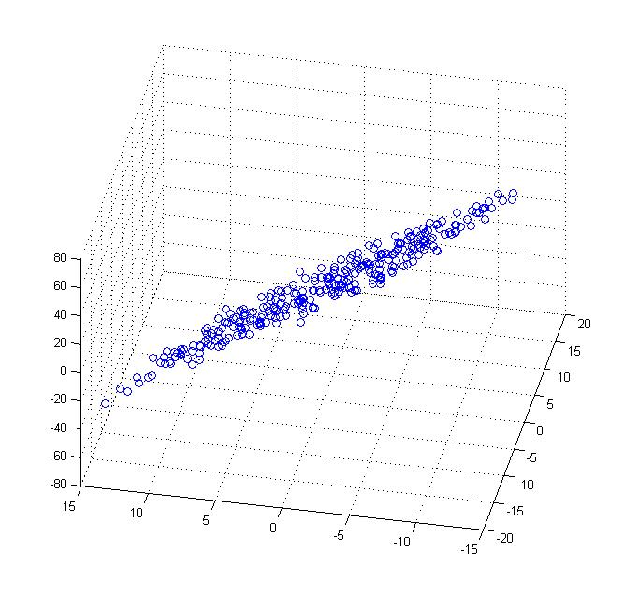
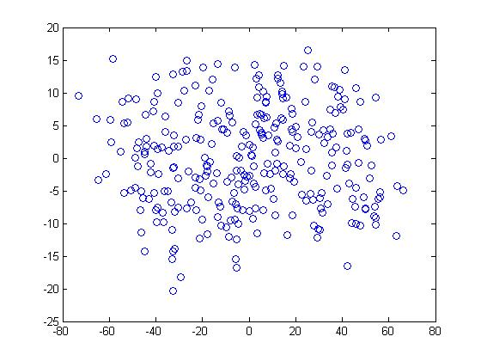


Data Compression
Reduce data from 3D to 2D
Andrew Ng
Notes:
Pca3d2d in lecture-slides/assets/pca/
Label axes

Slide 11
Basics of PCA
PCA is useful when we need to extract useful information from multivariate data sets.
This technique is based on the reduced dimensionality.
Therefore, trends in multivariate data are easily visualized.

Slide 12
Variable Reduction Procedure
Principal component analysis is a variable reduction procedure. It is useful when you have obtained data on a number of variables (possibly a large number of variables), and believe that there is some redundancy in those variables
Redundancy means that some of the variables are correlated with one another, possibly because they are measuring the same construct.
Because of this redundancy, you believe that it should be possible to reduce the observed variables into a smaller number of principal components (artificial variables) that will account for most of the variance in the observed variables.

Slide 13
What is Principal Component
A principal component can be defined as a linear combination of optimally-weighted observed variables.
Based on how subject scores on a principal component are
computed.

Slide 14

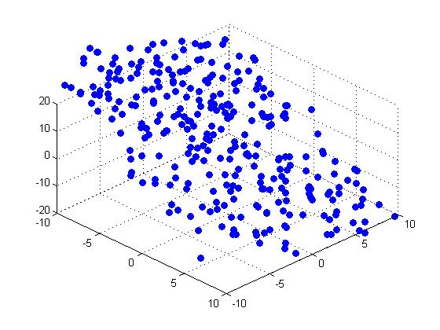


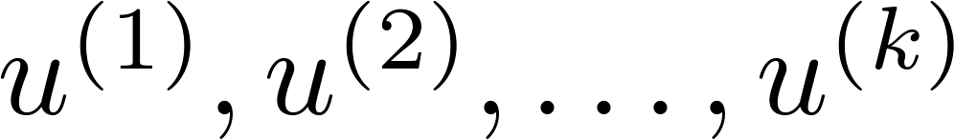
Principal Component Analysis (PCA) problem formulation
Reduce from 2-dimension to 1-dimension: Find a direction (a vector )
onto which to project the data so as to minimize the projection error.
Reduce from n-dimension to k-dimension: Find vectors
onto which to project the data, so as to minimize the projection error.
Andrew Ng
Notes:
Change numbers to LATEX as well

Slide 15
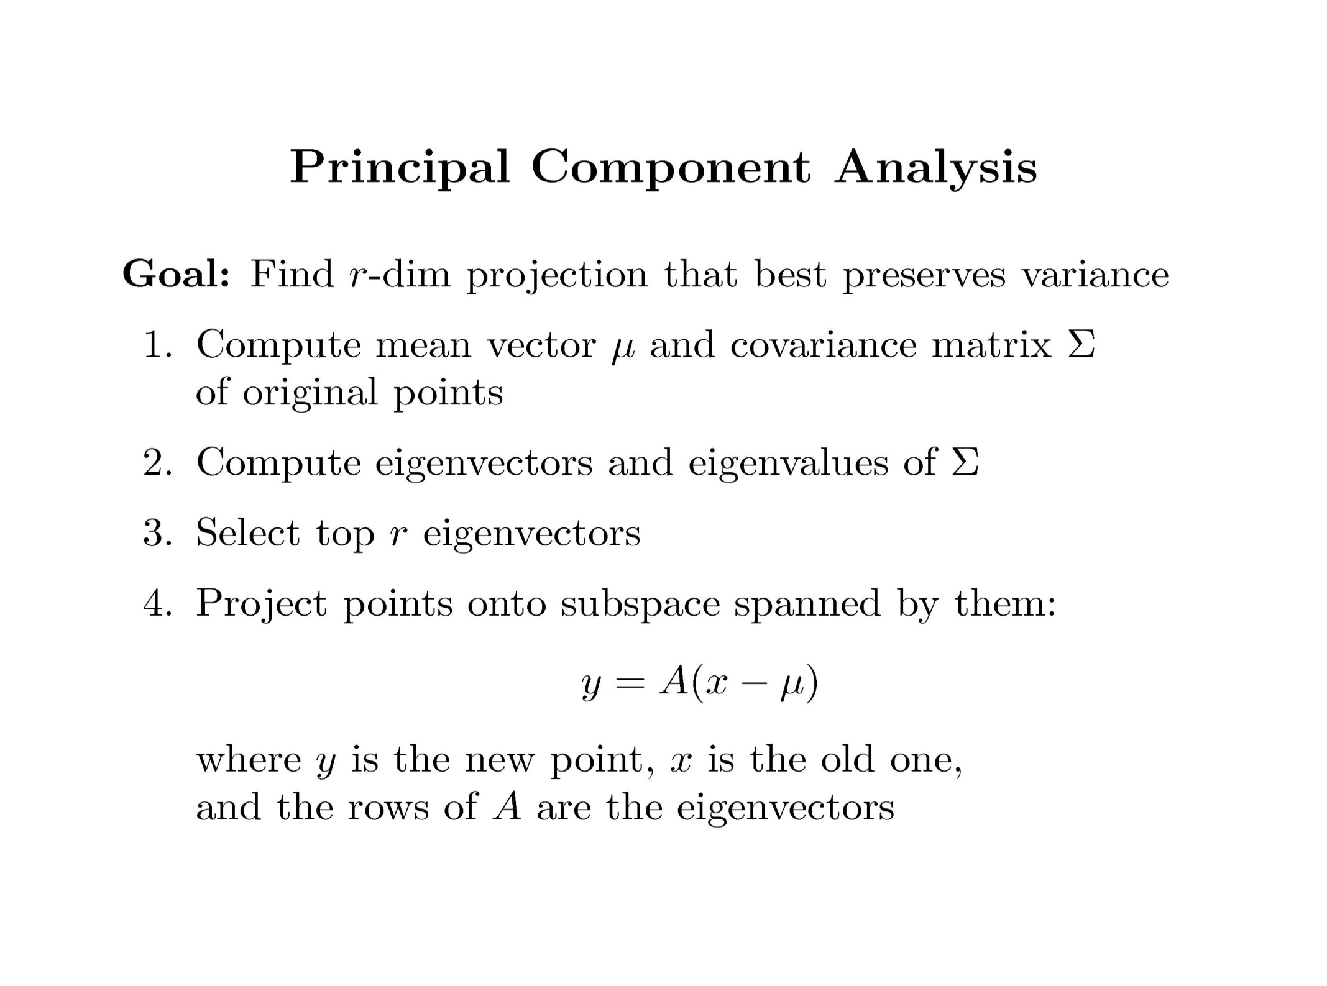

Slide 16
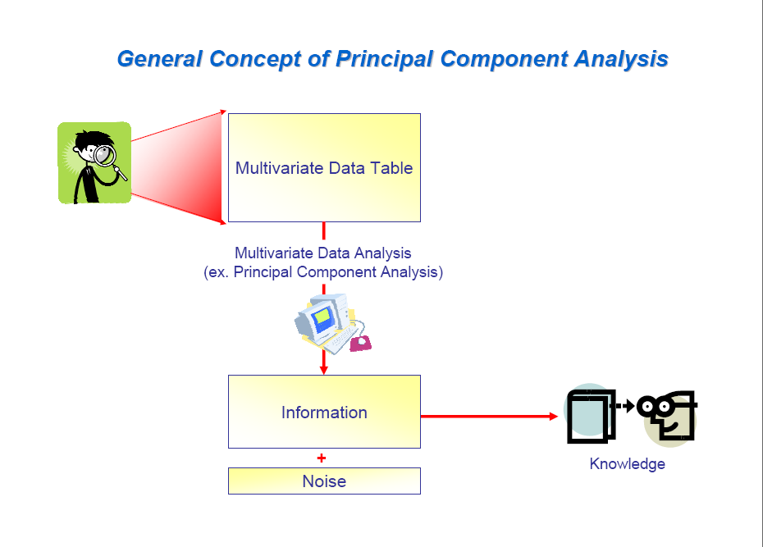

Slide 17
Covariance
Variance and Covariance:
Measure of the “spread” of a set of points around their center of mass(mean)
Variance:
Measure of the deviation from the mean for points in one dimension
Covariance:
Measure of how much each of the dimensions vary from the mean with respect to each other
Covariance is measured between two dimensions
Covariance sees if there is a relation between two dimensions
Covariance between one dimension is the variance

Slide 18
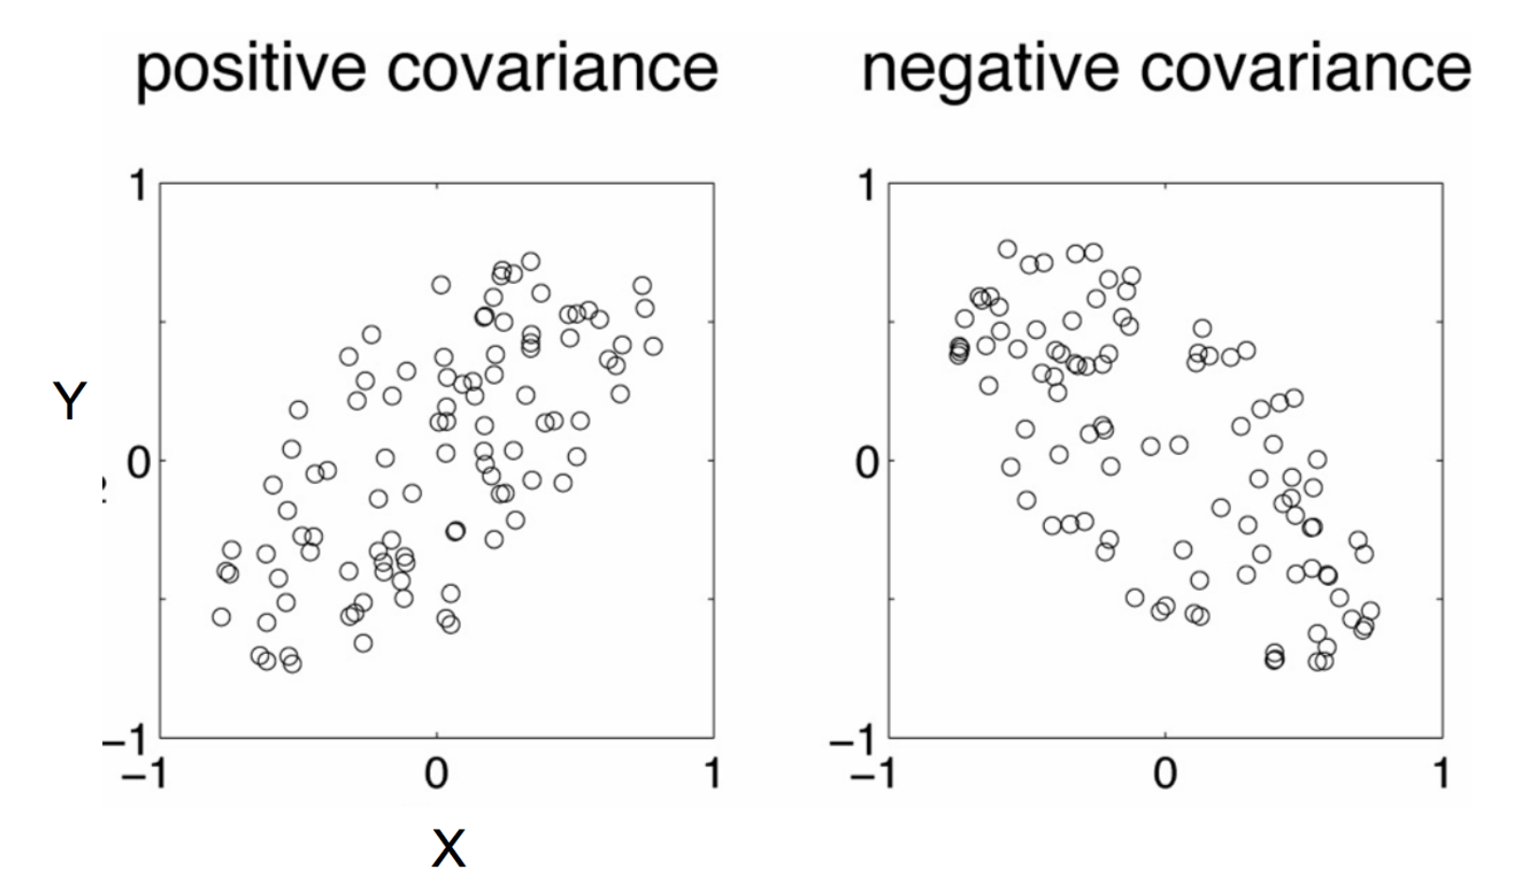
Positive: Both dimensions increase or decrease together
Negative: While one increase the other decrease

Slide 19
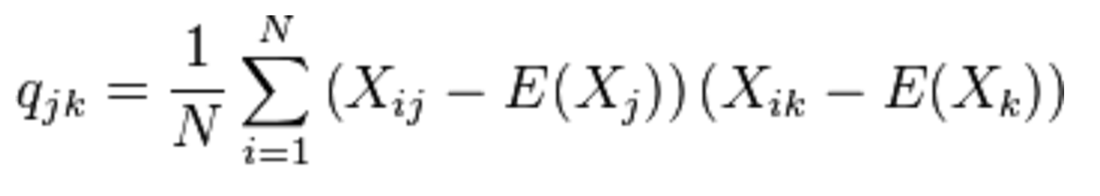
Covariance
Used to find relationships between dimensions in high dimensional data sets
The Sample mean

Slide 20
Eigenvector and Eigenvalue
Ax = λx
A: Square Matirx
λ: Eigenvector or characteristic vector
X: Eigenvalue or characteristic value
The zero vector can not be an eigenvector
The value zero can be eigenvalue

Slide 21
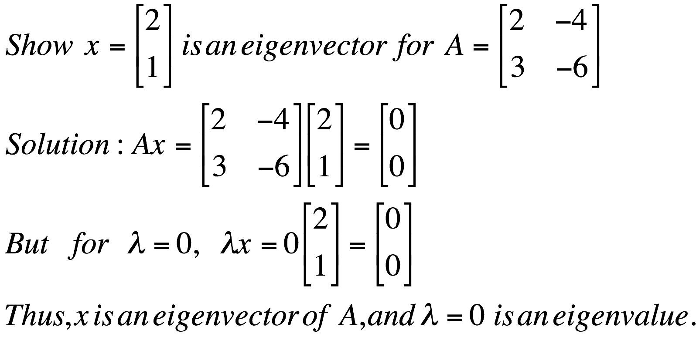
Eigenvector and Eigenvalue
Ax = λx
A: Square Matirx
λ: Eigenvector or characteristic vector
X: Eigenvalue or characteristic value
Example

Slide 22

Eigenvector and Eigenvalue
Ax - λx = 0
(A – λI)x = 0
Ax = λx
B = A – λI
Bx = 0
If we define a new matrix B:
x = B⁻¹0 = 0
BUT! an eigenvector cannot be zero!!
If B has an inverse:
x will be an eigenvector of A if and only if B does not have an inverse, or equivalently det(B)=0 :
det(A – λI) = 0

Slide 23
Eigenvector and Eigenvalue
Example 1: Find the eigenvalues of
two eigenvalues: −1, − 2
Note: The roots of the characteristic equation can be repeated. That is, λ₁ = λ₂ =…= λ_{k}. If that happens, the eigenvalue is said to be of multiplicity k.
Example 2: Find the eigenvalues of
λ = 2 is an eigenvector of multiplicity 3.

Slide 24


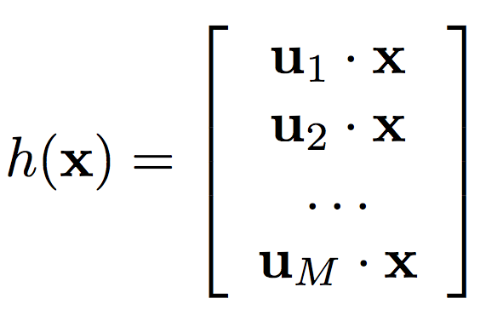

Principal Component Analysis
Input:
Set of basis vectors:
Summarize a D dimensional vector X with K dimensional feature vector h(x)

Slide 25
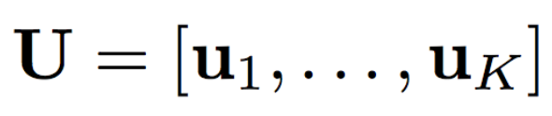
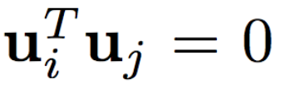
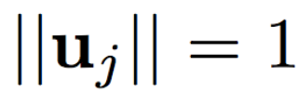

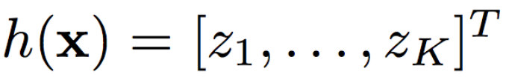
Principal Component Analysis
Basis vectors are orthonormal
New data representation h(x)

Slide 26
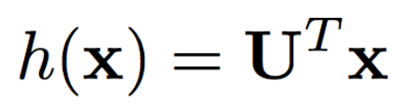
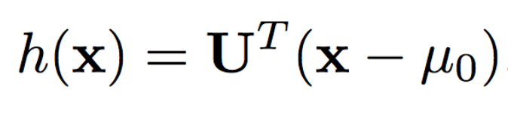
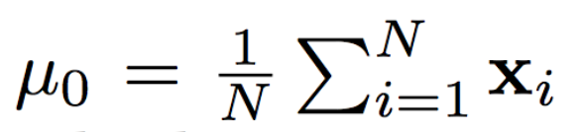
Principal Component Analysis
New data representation h(x)
Empirical mean of the data

Slide 27
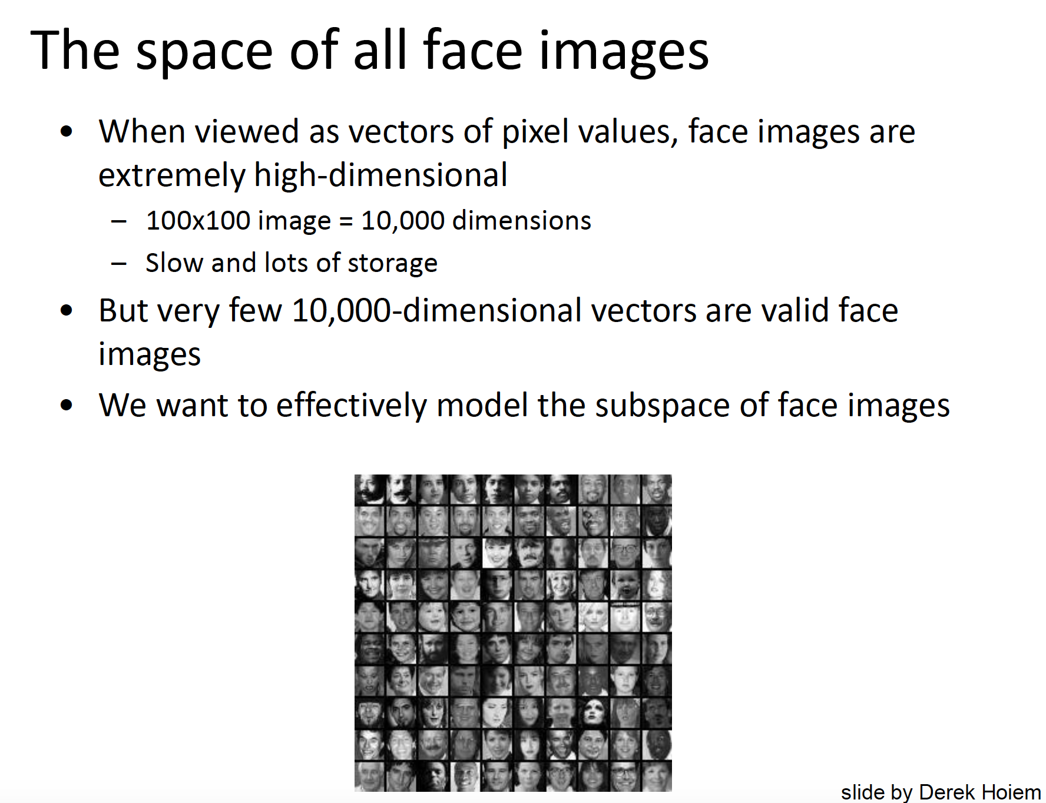

Slide 28

Original Image
Application: Image compression
Divide the original 372x492 image into patches:
Each patch is an instance that contains 12x12 pixels on a grid
View each as a 144-D vector

Slide 29

PCA compression: 144D → 60D

Slide 30

PCA compression: 144D → 16D

Slide 31
16 most important eigenvectors

Slide 32

PCA compression: 144D → 6D

Slide 33

6 most important eigenvectors

Slide 34
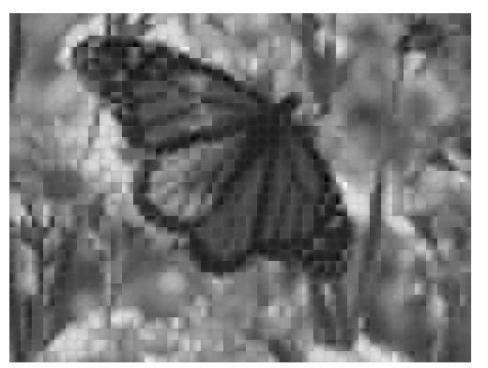
PCA compression: 144D → 3D

Slide 35
3 most important eigenvectors

Slide 36
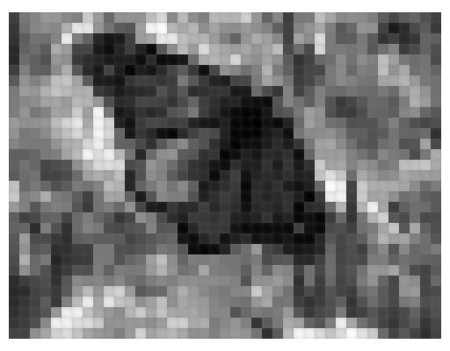
PCA compression: 144D → 1D

Slide 37
Dimensionality reduction
PCA (Principal Component Analysis):
Find projection that maximize the variance
ICA (Independent Component Analysis):
Very similar to PCA except that it assumes non-Guassian features
Multidimensional Scaling:
Find projection that best preserves inter-point distances
LDA(Linear Discriminant Analysis):
Maximizing the component axes for class-separation
…
…

Slide 38
Characteristics of principal components
The first component extracted in a principal component analysis accounts for a maximal amount of total variance in the observed variables.
Under typical conditions, this means that the first component will be correlated with at least some of the observed variables. It may be correlated with many.
The second component extracted will have two important characteristics. First, this component will account for a maximal amount of variance in the data set that was not accounted for by the first component.

Slide 39
Under typical conditions, this means that the second component will be correlated with some of the observed variables that did not display strong correlations with component 1.
The second characteristic of the second component is that it will be uncorrelated with the first component. Literally, if you were to compute the correlation between components 1 and 2, that correlation would be zero.
The remaining components that are extracted in the analysis display the same two characteristics: each component accounts for a maximal amount of variance in the observed variables that was not accounted for by the preceding components, and is uncorrelated with all of the preceding components.

Slide 40
Generalization
A principal component analysis proceeds in this fashion, with each new component accounting for progressively smaller and smaller amounts of variance (this is why only the first few components are usually retained and interpreted).
When the analysis is complete, the resulting components will display varying degrees of correlation with the observed variables, but are completely uncorrelated with one another.

Slide 41
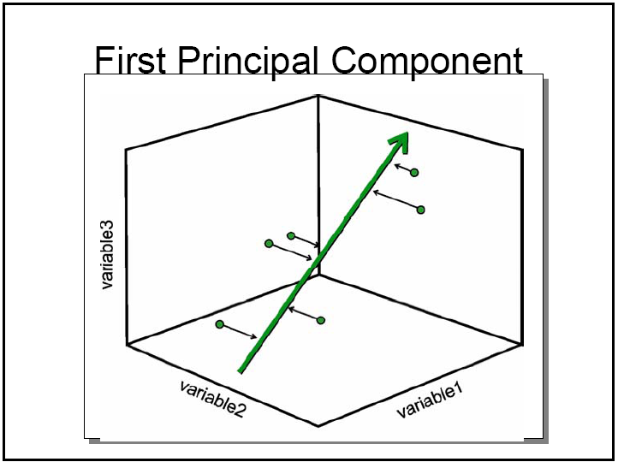

Slide 42
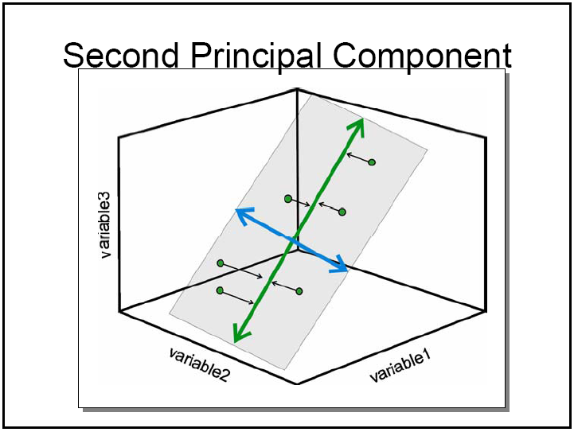

Slide 43
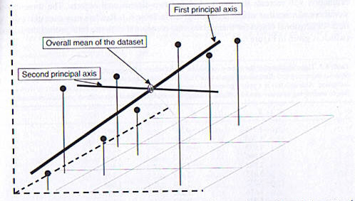

Slide 44
References
Books and Journals
Understanding Machine Learning: From Theory to Algorithms by Shai Shalev-Shwartz and Shai Ben-David-Cambridge University Press 2014
Introduction to machine Learning – the Wikipedia Guide by Osman Omer.
Video Link-
https://www.youtube.com/watch?v=FgakZw6K1QQ
https://www.youtube.com/watch?v=fkf4IBRSeEc
Web Link-
http://www.stats.org.uk/pca/
https://link.springer.com/10.1007%2F978-3-642-04898-2_455
https://analyse-it.com/docs/user-guide/multivariate/pca

